Slide 1
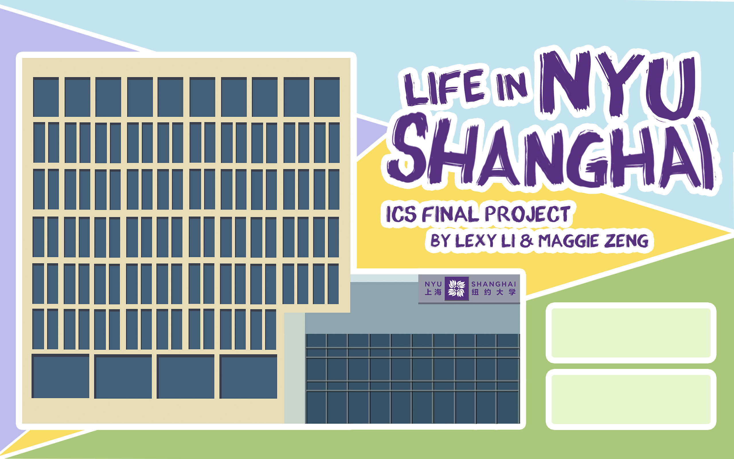



Slide 2

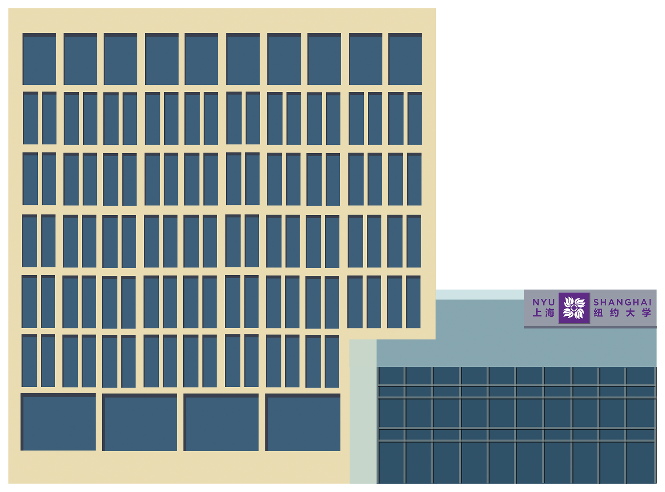
Basic information
Game Rules
Game interface
Demo
Q&A

Slide 3
1. Game Introduction
- Topics: GUI + Online Game
- Tools: pyqt5 + Python3.6
- A monopoly game based on the real life in NYUSH
- Allow two players playing on different computers

Slide 4
2. Game Rules
Two Players
Buy House to get payment from the other
Upgrade the building ( 3 levels)
Special buildings:
CDC : Good things - get money
Student Life: Hard life - lose money
Bursa: Get loan
314, Family mart: places for a rest
Two ways to win the game

Slide 5

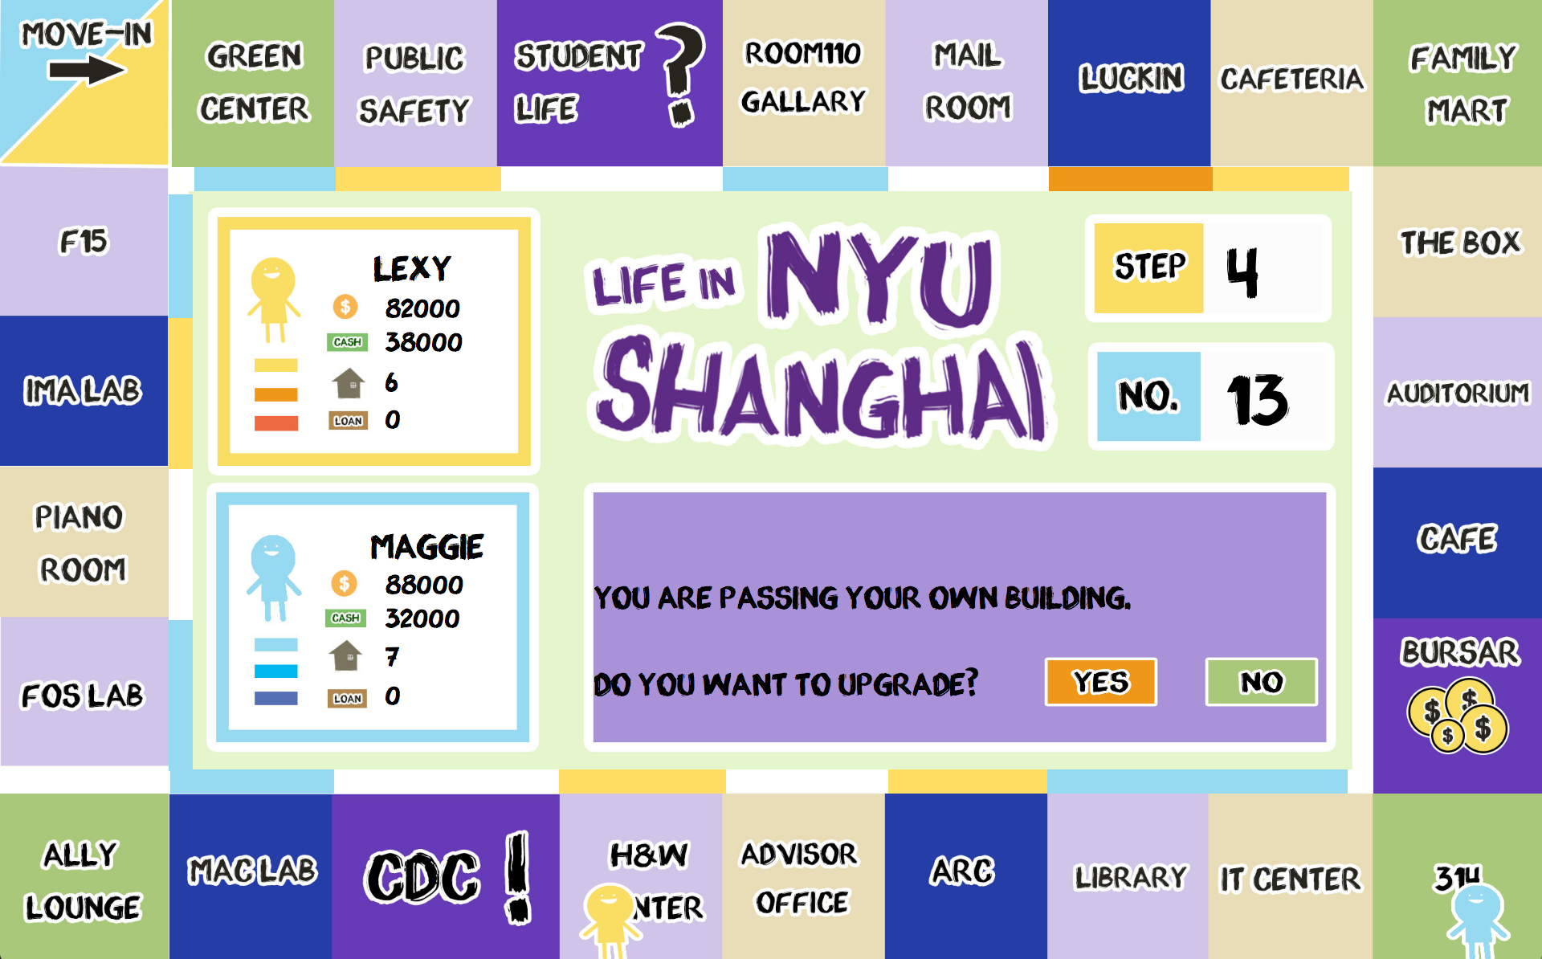
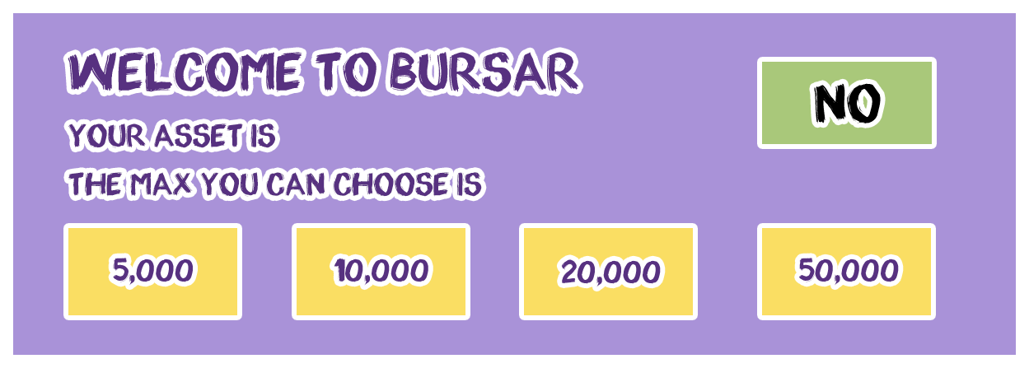
2. Game interface
2 interface
2 characters
2 player profiles
2 numbers
2 info frame
20+6 Buildings
3 colors for building level

Slide 6

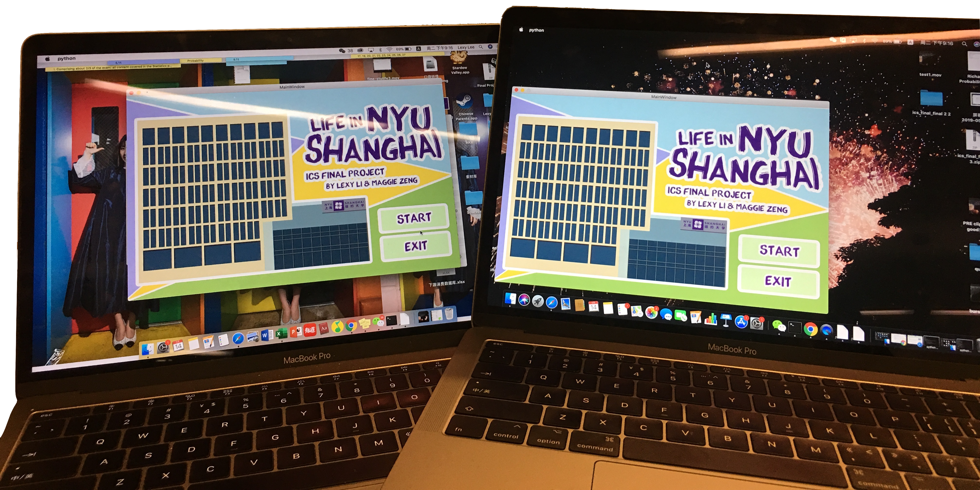
3. Game Demo Game Demo Game Demo Game Demo Game Demo Game Demo Game Demo Game Demo Game Demo Game Demo Game Demo Game Demo Game Demo Game Demo Game Demo Game Demo Game Demo Game Demo Game Demo Game Demo Game Demo Game Demo Game Demo Game Demo Game Demo Game Demo Game Demo Game Demo Game Demo Game Demo Game Demo Game Demo Game Demo Game Demo Game

Slide 7



Q&A

Slide 8
Much Thanks to Everyone!

